Slide 1


Supply Chain Simulation:
Cinedom
Professor: Sabrina Bonzelet & Stephanie Rauscher
Speakers: Chenyu Zhang, Daniil Sideris
Date: 19.05.2022 (Summer Term 2022)
University of Cologne
Depatment of Supply Chain Management and Management Science
Supply Chain Management (Bachelorseminar)

Slide 2
Table of contents
Conceptual Modeling
Input Analysis
Simulation of Process in Anylogic (Status quo)
Process Optimization
Evaluation / Output Analysis
Conclusion
Department of Supply Chain Management and Management Science
Supply Chain Management (Bachelorseminar) 19.05.2022

Slide 3
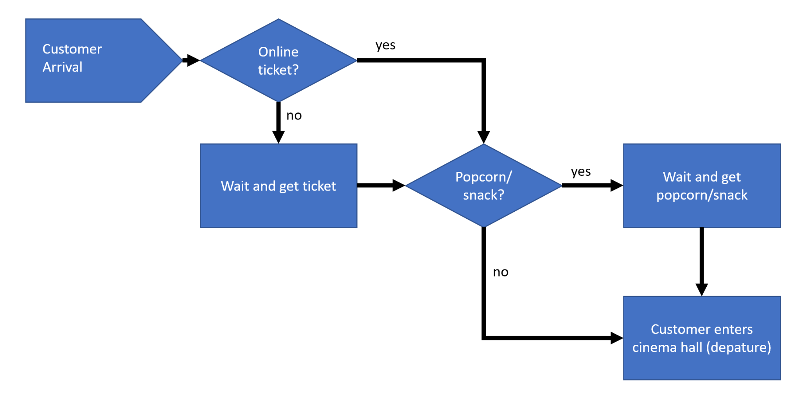
Conceptual Modeling
Overall goals of the simulation study
Performance measures
Process flow diagram
Functionality and interaction of the subsystems
Simplifying assumptions
Limitations of the model
Source: Own drawing
Department of Supply Chain Management and Management Science
Supply Chain Management (Bachelorseminar) 19.05.2022

Slide 4
Input Analysis
Methods of observed data:
Customer’s waiting time in queues and processes
Customers with online or printed tickets, with or without snacks
Interviews with staff and managers
Application: Python and libraries: Pandas, NumPy, SciPy, fitter
Department of Supply Chain Management and Management Science
Supply Chain Management (Bachelorseminar) 19.05.2022

Slide 5
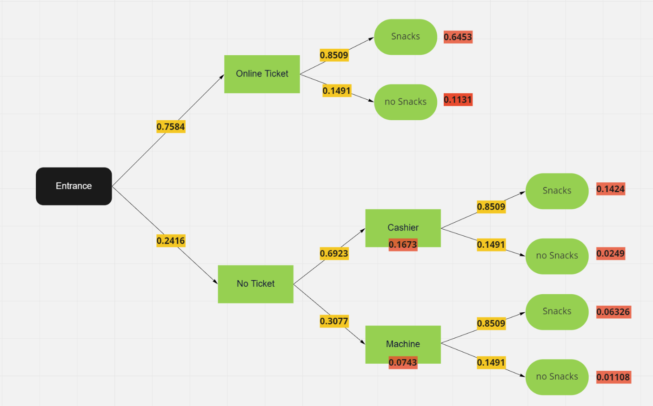
Input Analysis: Probabilities
Probabilities which we know
Joint Probabilities
P(A and B) = P(A) * P(B)
Source: own figure created with Miro
Department of Supply Chain Management and Management Science
Supply Chain Management (Bachelorseminar) 19.05.2022

Slide 6
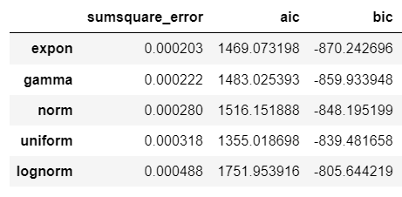
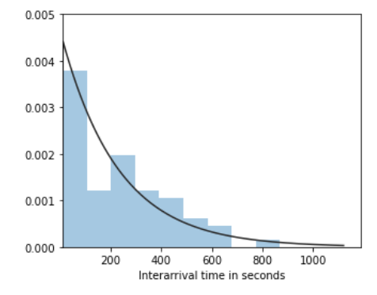
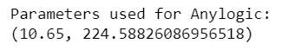
Input Analysis: Distributions
Example on the time in queue at the Snackbar
Fitting 6 most common distributions: chi2, exponential, gamma, lognormal, normal, uniform
Choose the distribution with the smallest sum square of errors, AIC and BIC
Check the fitted distribution on the plot
Extract parameters for anylogic
Source: Python output
Department of Supply Chain Management and Management Science
Supply Chain Management (Bachelorseminar) 19.05.2022

Slide 7
Input Analysis: Distributions
Interarrival Time: lognormal(2.2121, 0.5943, 1.48)
Ticket Machine: lognormal(4.1590, 0.1956, 42.0)
Ticket Cashier: lognormal(4.6944, 0.2526, 34.0)
Snack Queue: exponential(10.65, 224.5883)
Snack Ordering: gamma(1.4013, 17.7216, 5.07)
Snack Preparing: gamma(2.8497, 15.5137, 1.48)
Snack Paying: lognorm(3.0277, 0.7901, 1.18)
Total Time Snackbar: chi2(2.9064, 60.88)
Special distributions for the improved model:
Ordering only snack: lognorm(3.6285, 0.6914, 13.46)
Ordering Tickets and snack: exponential(86.2230, 32.47)
Ordering Ticket: lognormal(4.1590, 0.1956, 42.0)
Department of Supply Chain Management and Management Science
Supply Chain Management (Bachelorseminar) 19.05.2022

Slide 8
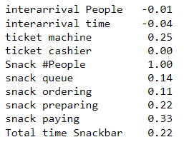
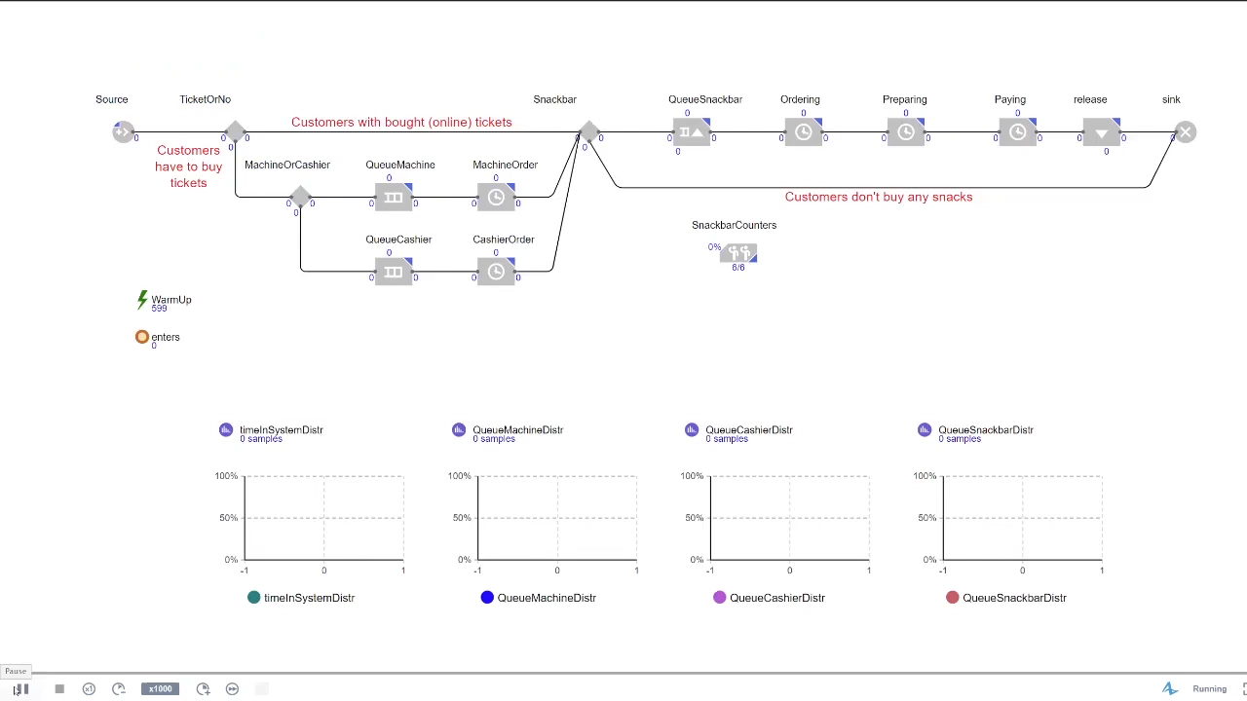
Simulation of the Process in Anylogic
Simulated time = 2 hours (7200 seconds) + 10 min WarmUp (600 seconds)
Number of replications: 10
Correlation between People and all variables (Source: Python output)
Department of Supply Chain Management and Management Science
Supply Chain Management (Bachelorseminar) 19.05.2022

Slide 9
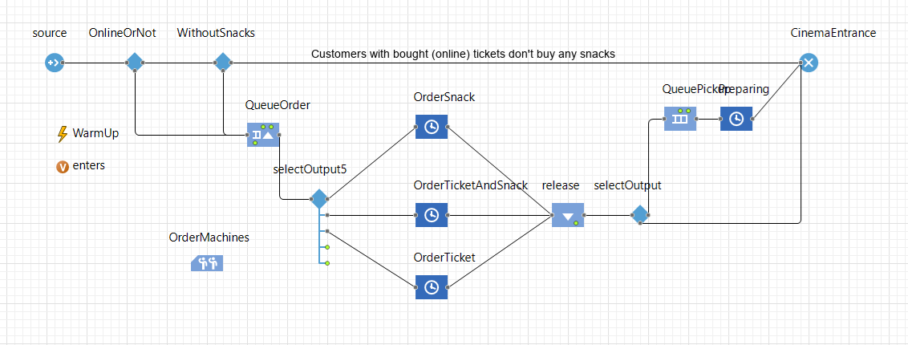
Process Optimization
Decision 1
Decision 2
Joint queue
Source: AnyLogic
Department of Supply Chain Management and Management Science
Supply Chain Management (Bachelorseminar) 19.05.2022

Slide 10
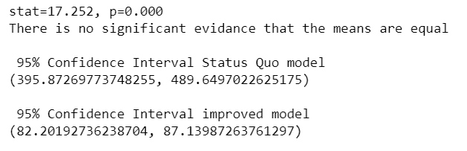
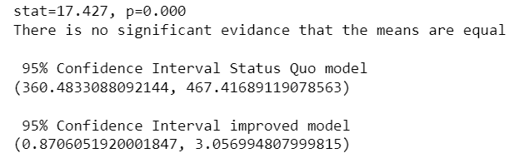
Output Analysis
mean(TotalTimeInSystemStatusQuo) = 442.76
mean(TotalWaitingTimeStatusQuo) = 413.95
mean(TotalTimeInSystemImproved) = 84.67
mean(TotalWaitingTimeImproved) = 1.96
Student’s t-test on the samples: H0: the means of the samples are equal. H1: the means of the samples are unequal.
Total Time in the System (Source: Python output)
Total Waiting Time (Source: Python output)
Department of Supply Chain Management and Management Science
Supply Chain Management (Bachelorseminar) 19.05.2022

Slide 11
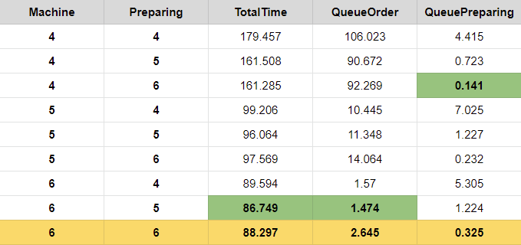
Evaluation: capacities
Source: CSV-File “Capacity_comparison.csv”
(Styled with Google Docs Editors suite, Google Sheets)
Department of Supply Chain Management and Management Science
Supply Chain Management (Bachelorseminar) 19.05.2022

Slide 12
Conclusion
Simulation of process with real-life data
Process Optimazition:
Reprogramming of the ticketing machines
Queue management
Evaluation: significant waiting and total time reduction
Another optimization idea: self-serve snackbar
Department of Supply Chain Management and Management Science
Supply Chain Management (Bachelorseminar) 19.05.2022

Slide 13
Thank you for your attention!
Department of Supply Chain Management and Management Science
Supply Chain Management (Bachelorseminar) 19.05.2022

